Slide 1
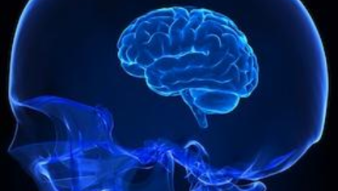
Overview of the TREC 2019 Deep Learning Track
Nick Craswell*, Bhaskar Mitra*, Emine Yilmaz+, Daniel Campos* *Microsoft +University College London

Slide 2
Overview of the TREC 2019 Deep Learning Track
Nick Craswell*, Bhaskar Mitra*, Emine Yilmaz+, Daniel Campos* *Microsoft +University College London

Slide 3
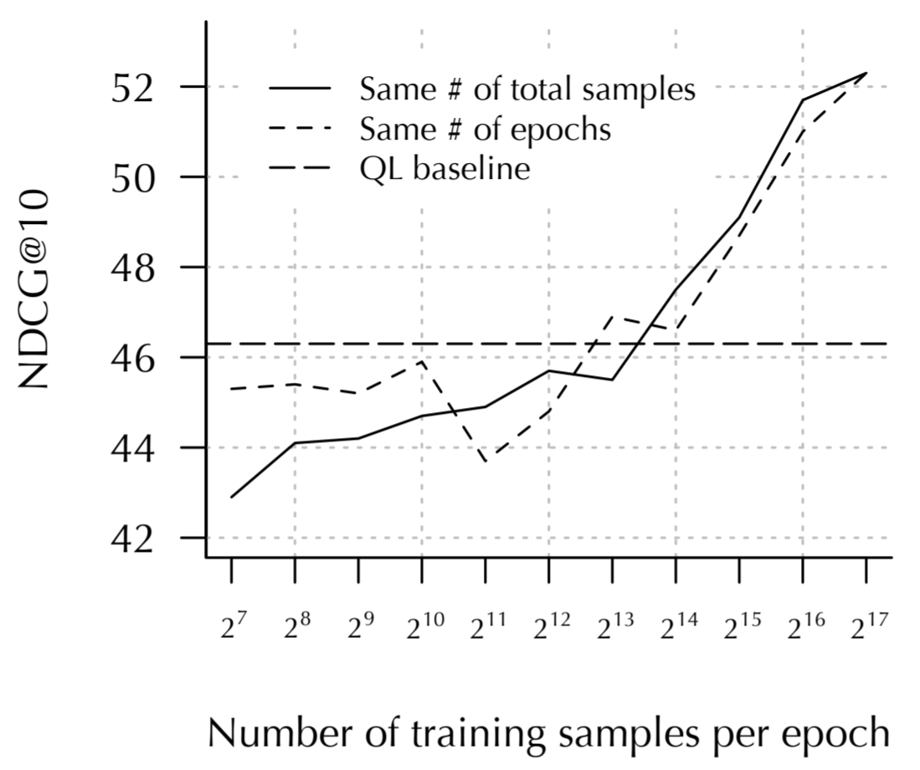
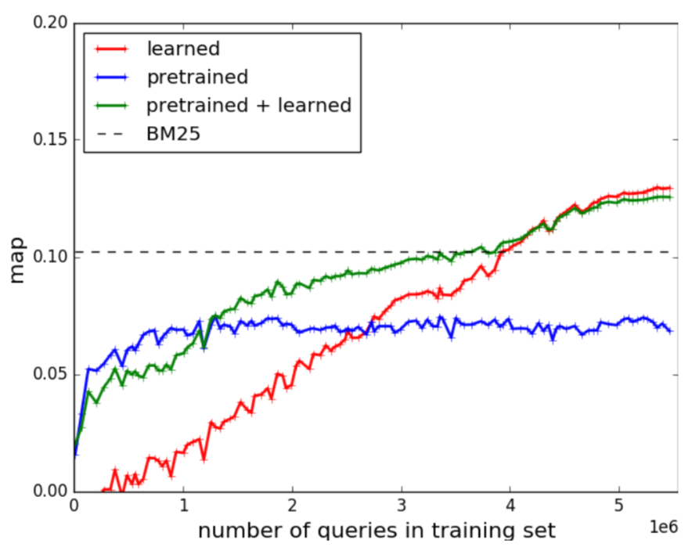
Goal: Large, human-labeled, open data
Mitra, Diaz and Craswell. Learning to match using local and distributed representations of text for web search.
WWW 2017
Dehghani, Zamani, Severyn, Kamps and Croft. Neural ranking models with weak supervision. SIGIR 2017
TREC 2019 Deep Learning Track
Past: Proprietary data
Past: Weak supervision
Here: New datasets
Promising
Promising?
Promising
Better search results
More data
200K queries, human-labeled, proprietary
1+M queries, weak supervision, open
300+K queries, human-labeled, open

Slide 4


Deriving our TREC 2019 datasets
MS MARCO QnA Leaderboard
1M real queries
MS MARCO Passage Retrieval Leaderboard
Corpus: Union of 10-passage sets
TREC 2019 Task: Passage Retrieval
Same corpus, training Q+labels
New reusable NIST test set
TREC 2019 Task: Document Retrieval
10 passages per Q
Human annotation says ~1 of 10 answers the query
Labels: From the ~1 positive passage
Labels: Transfer from passage to doc
Corpus: Documents (crawl passage urls)
New reusable NIST test set
http://msmarco.org
https://microsoft.github.io/TREC-2019-Deep-Learning/

Slide 5
Deep Learning Track
Main question: What works best in a large data regime?
“nnlm”: Neural network runs that use a large BERT-style language model
“nn”: Other neural network runs
“trad”: Runs based on traditional TREC techniques such as BM25 and RM3
Additional question: End-to-end retrieval (“fullrank”) vs top-k reranking (“rerank”). Passage k=1000. Document k=100.
2019 DL Track Task | Training data | Test data | Corpus
1) Document retrieval | 367K queries | 43 queries | 3.2M documents
2) Passage retrieval | 502K queries | 43 queries | 8.8M passages

Slide 6
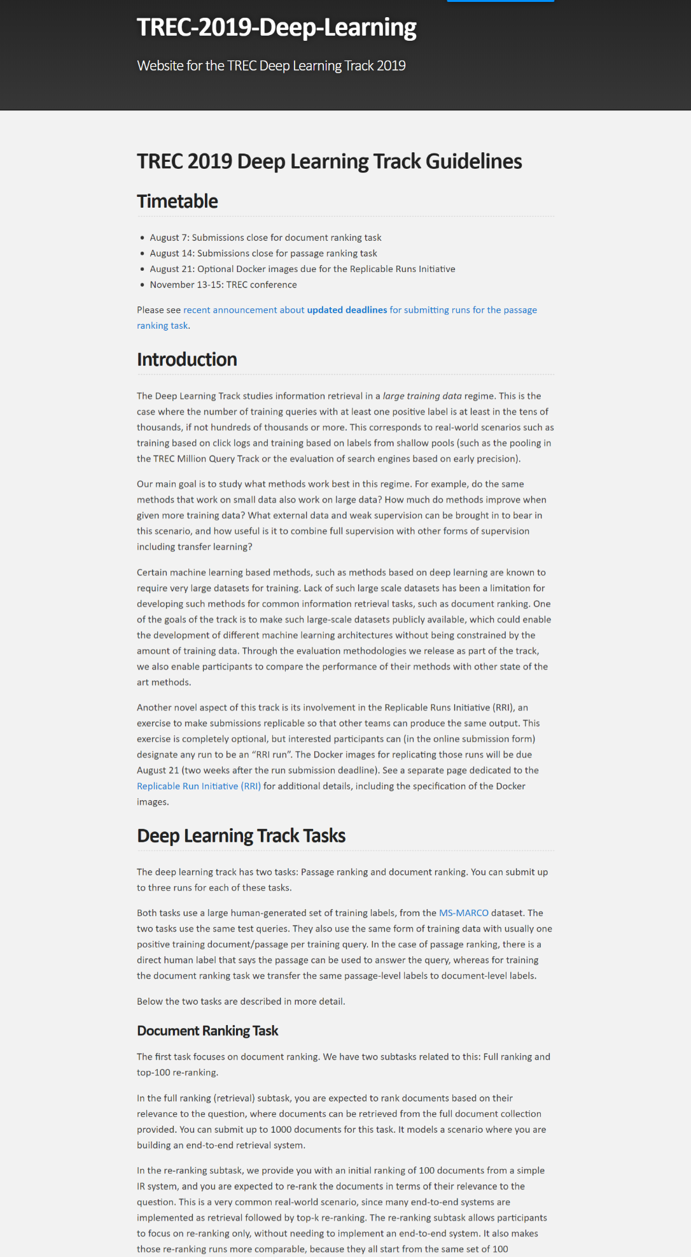
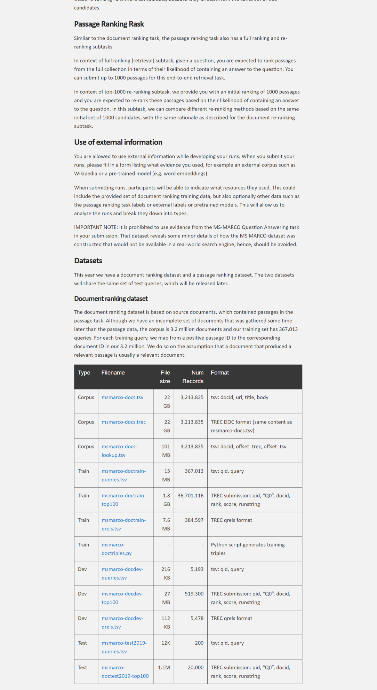
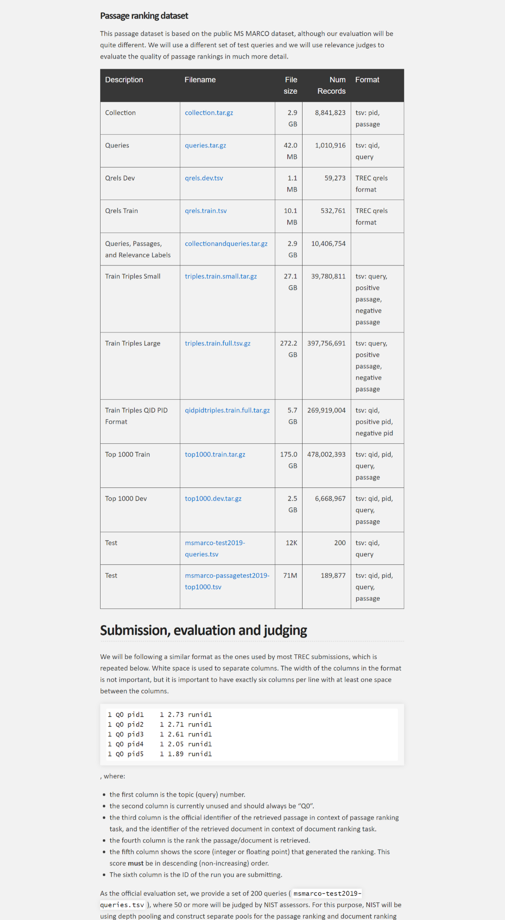
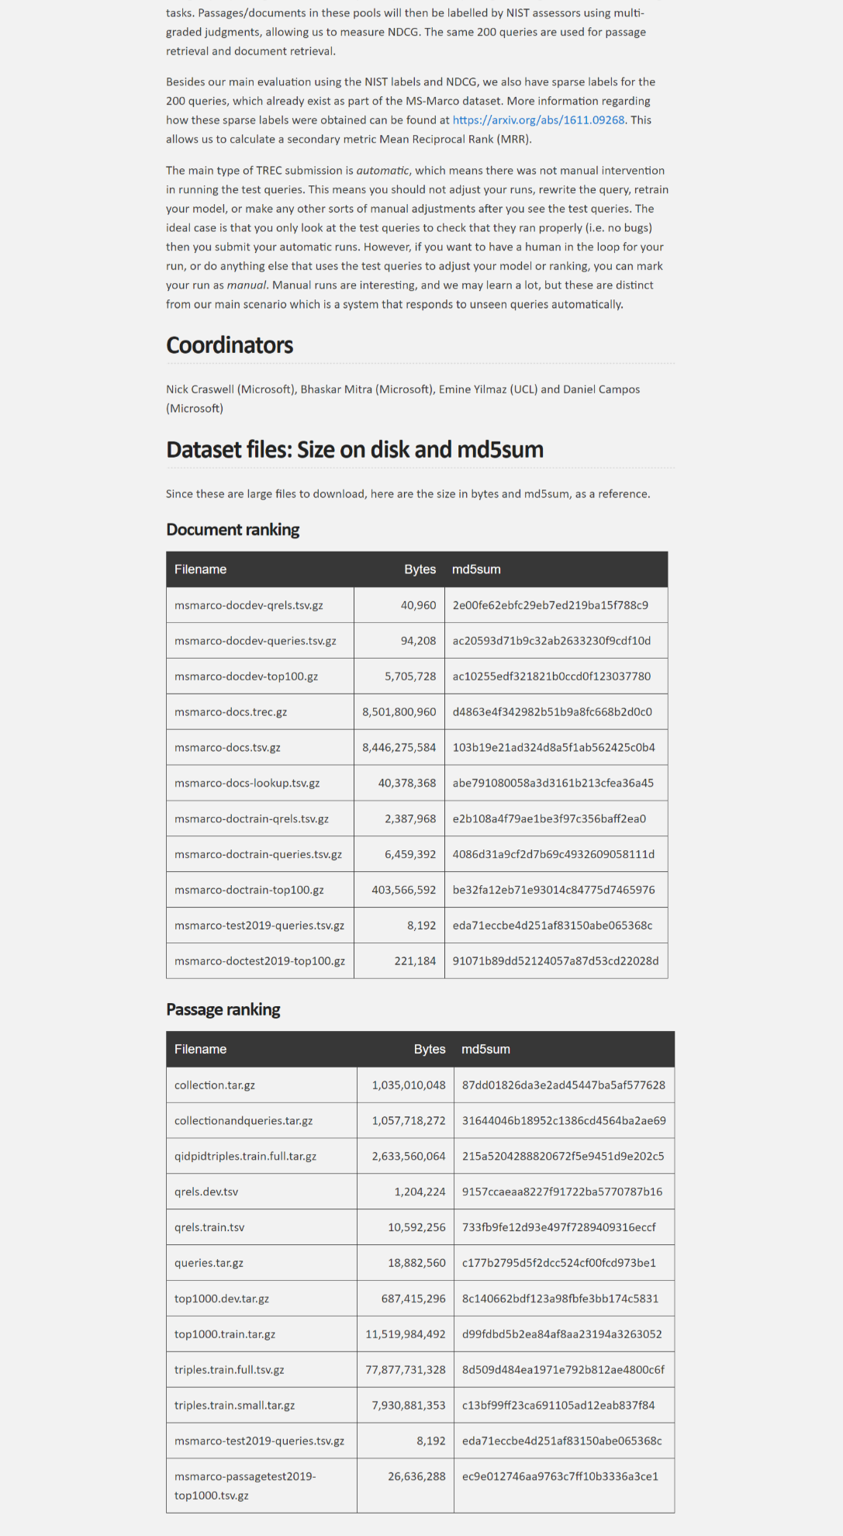
Passage data →
DL Track data, available now.
Note: NIST labels are available to participants now, and more broadly in Feb 2020.
Document data →
https://microsoft.github.io/TREC-2019-Deep-Learning/

Slide 7
Goal: TREC-style rigorous evaluation
Let’s avoid certain problems with baselines/overfitting/bias
By running a track at TREC:
Any/all baselines and model types can be included
They can be properly optimized
Avoid selective reporting (publication bias)
Avoid multiple testing on the same test set (overfitting)
Most convincing: Submit docker, before you see the test queries or labels
Very convincing: Run test queries (don’t look!), submit runs, before you see labels
Less convincing but OK: Reuse test queries+labels later
There can be a minor distribution shift from train to test, testing robustness(!)
Please participate in 2020. The more we try, the more we know

Slide 8
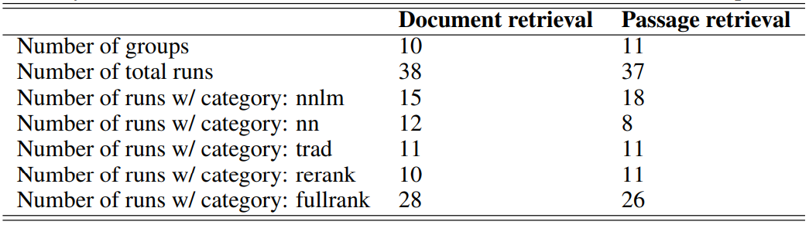
Runs

Slide 9
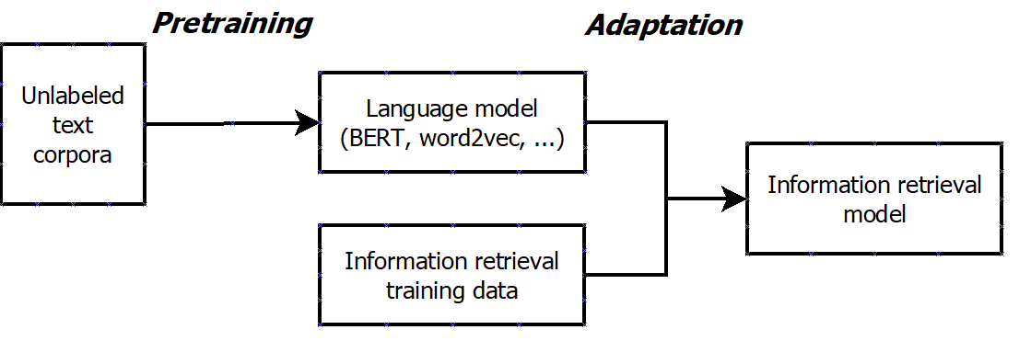
Popular in 2019: Sequential transfer learning
Can be used in “nnlm” and “nn” runs:
“nnlm” if the pretrained model is BERT or similar
“nn” if the pretrained model is word2vec or similar

Slide 10
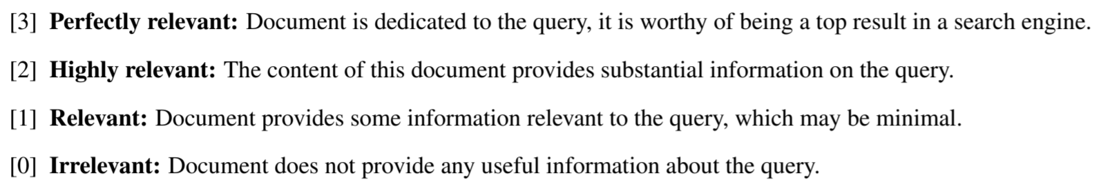
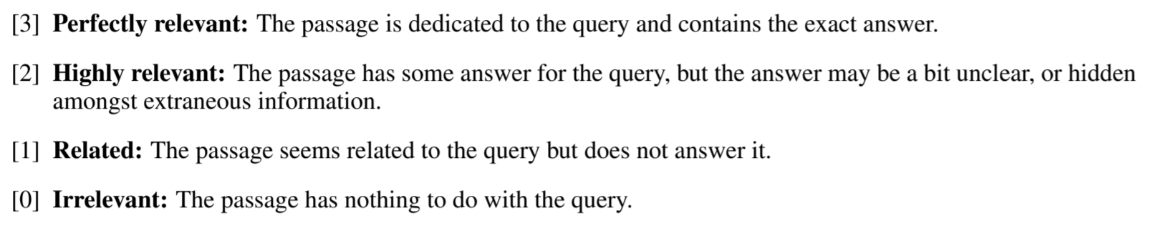
NIST judgments
rel | #doc | #pass
3 | 841 | 697
2 | 1149 | 1804
1 | 4607 | 1601
0 | 9661 | 5158
Document retrieval task
Passage retrieval task

Slide 11
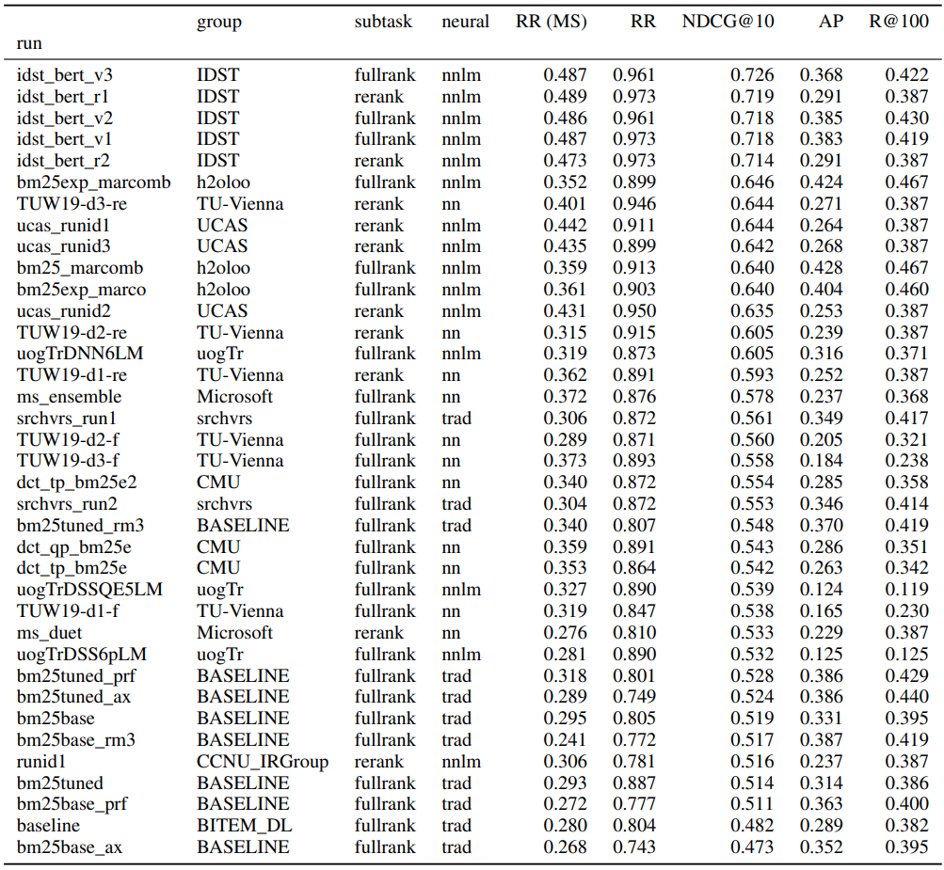
Document retrieval task
Main metric: NDCG@10
Focus on top of ranking
Avoid binarizing labels
“nnlm” runs tend to perform best
Significant wins over “trad”

Slide 12
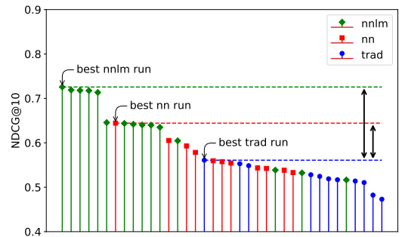

Slide 13
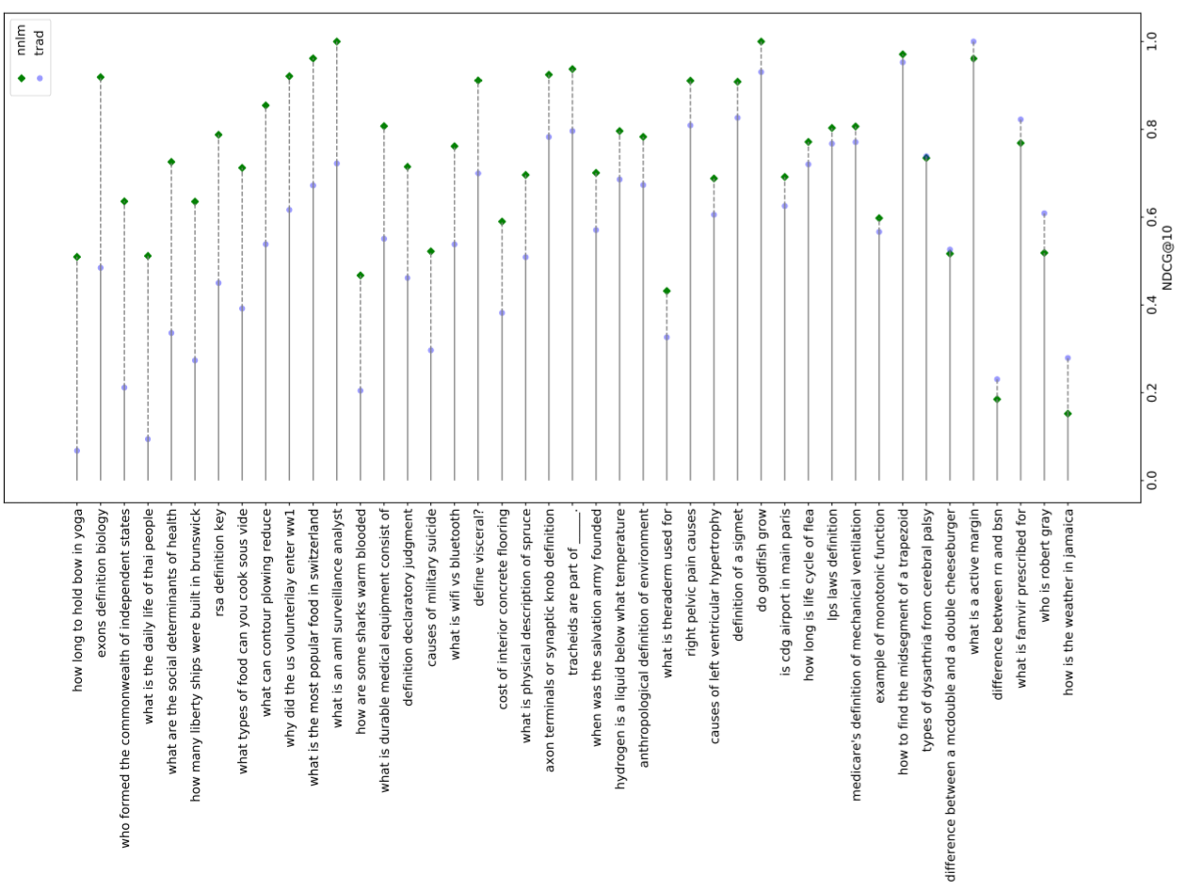

Slide 14
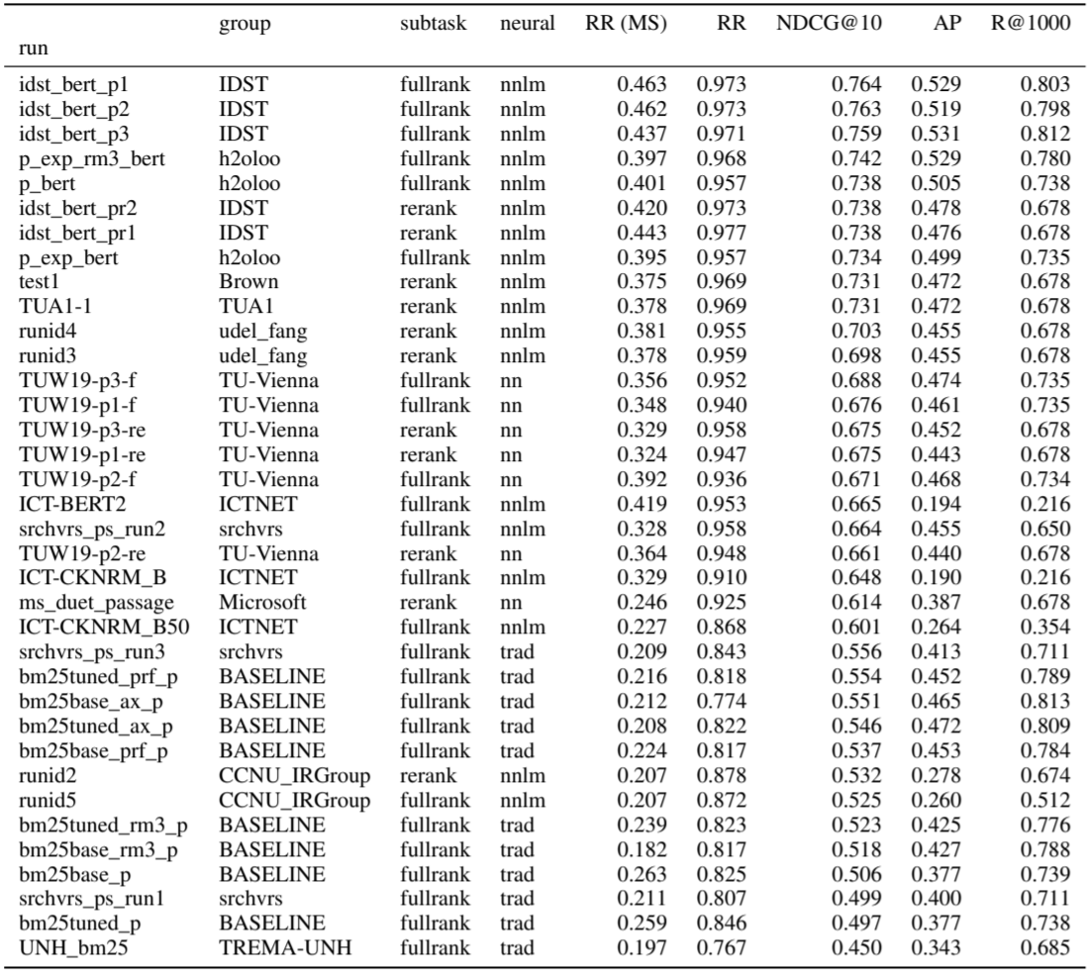
Passage retrieval task
Main metric: NDCG@10
Focus on top of ranking
Avoid binarizing labels
“nnlm” runs tend to perform best
Even more significant wins over “trad”

Slide 15
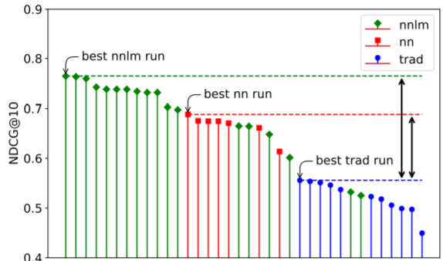

Slide 16
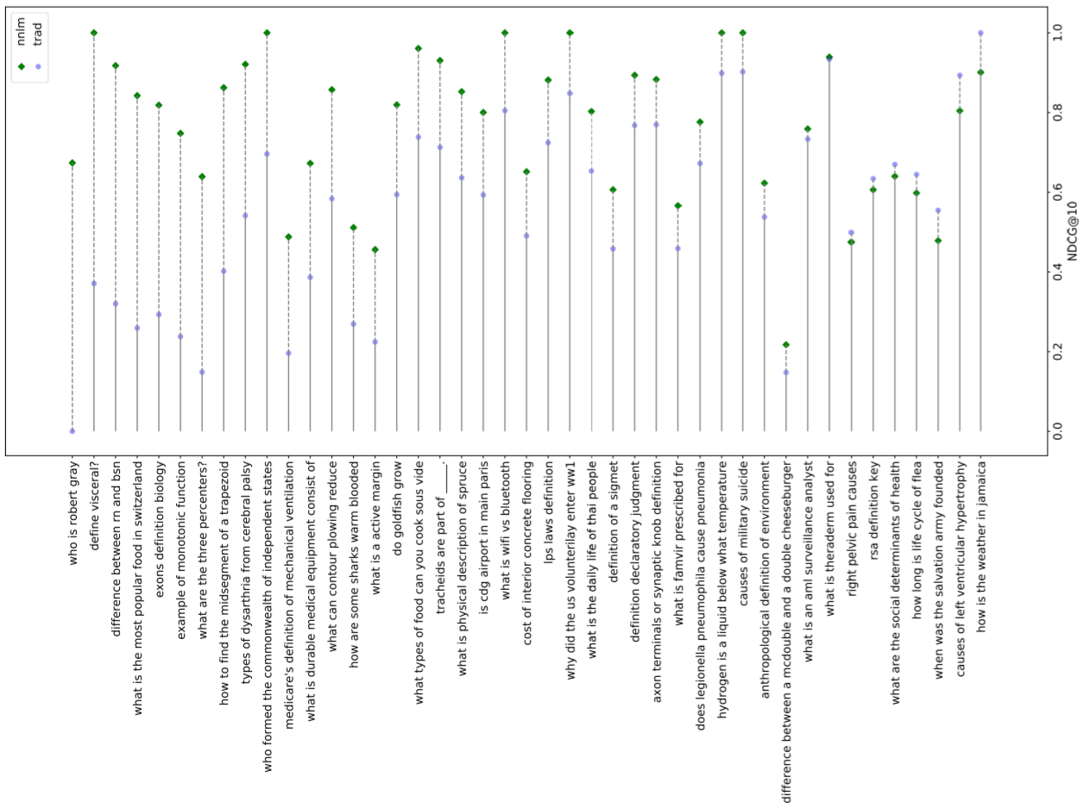

Slide 17
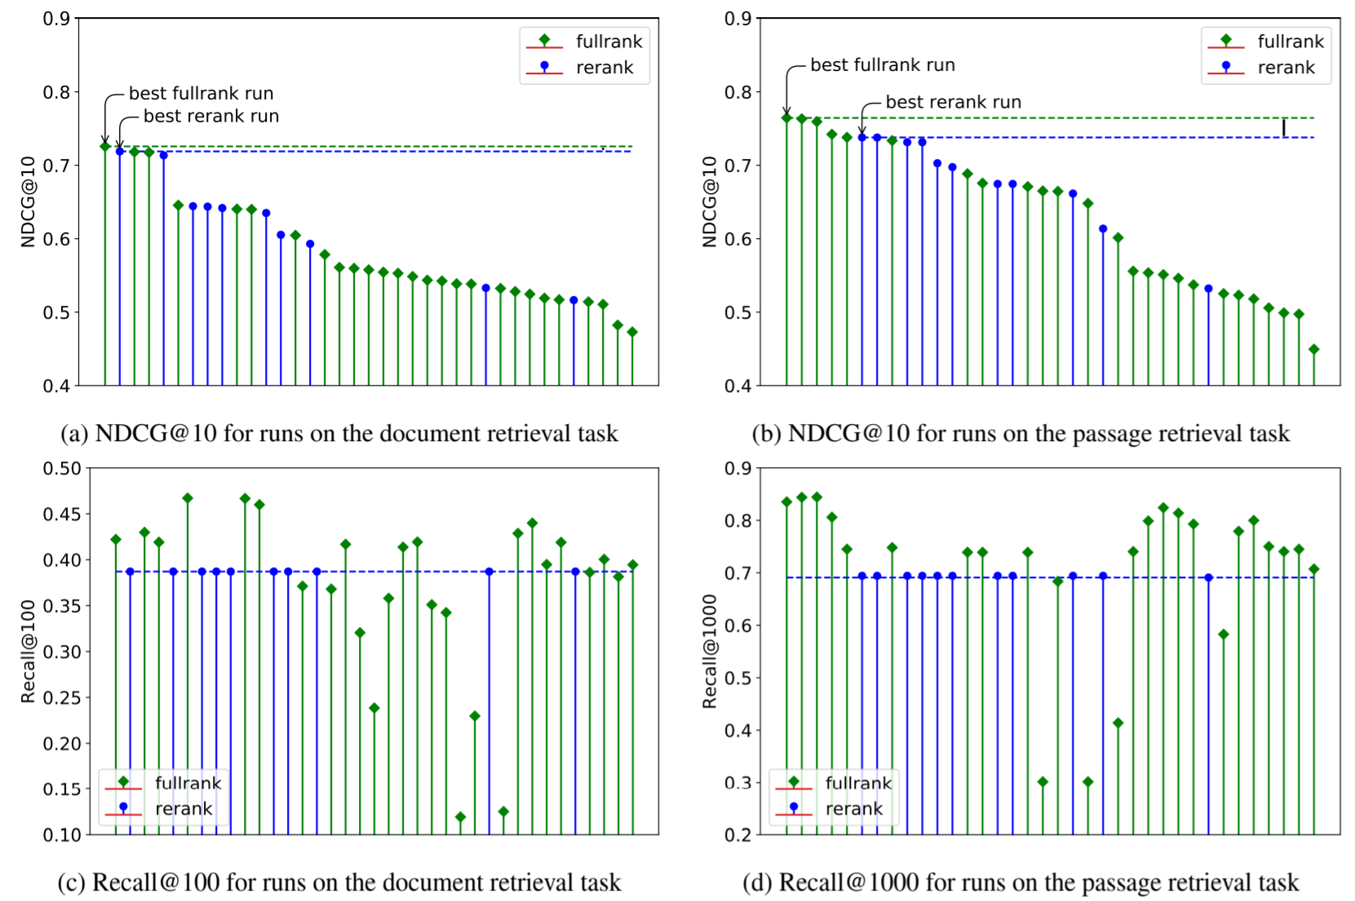

Slide 18
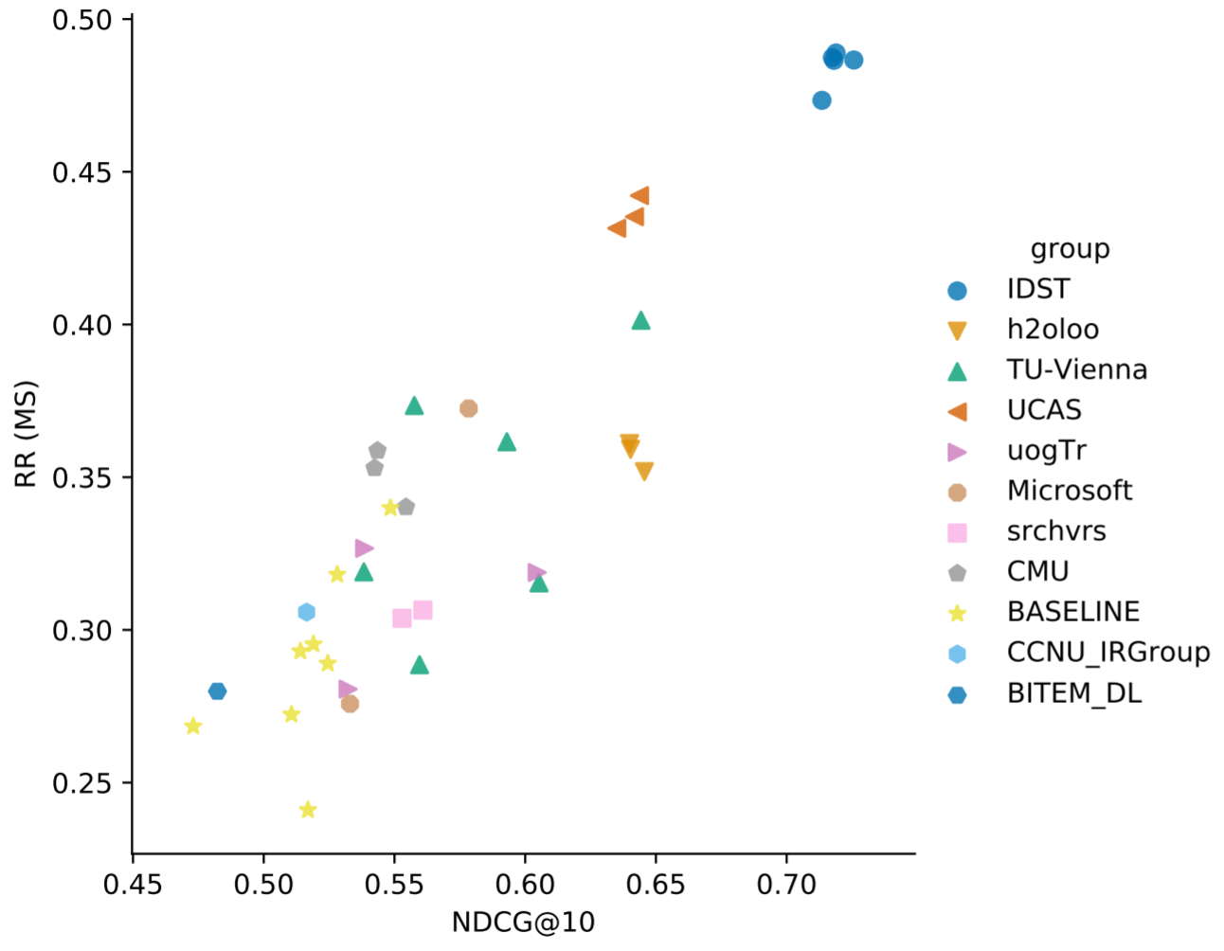
Metrics analysis: Document ranking

Slide 19
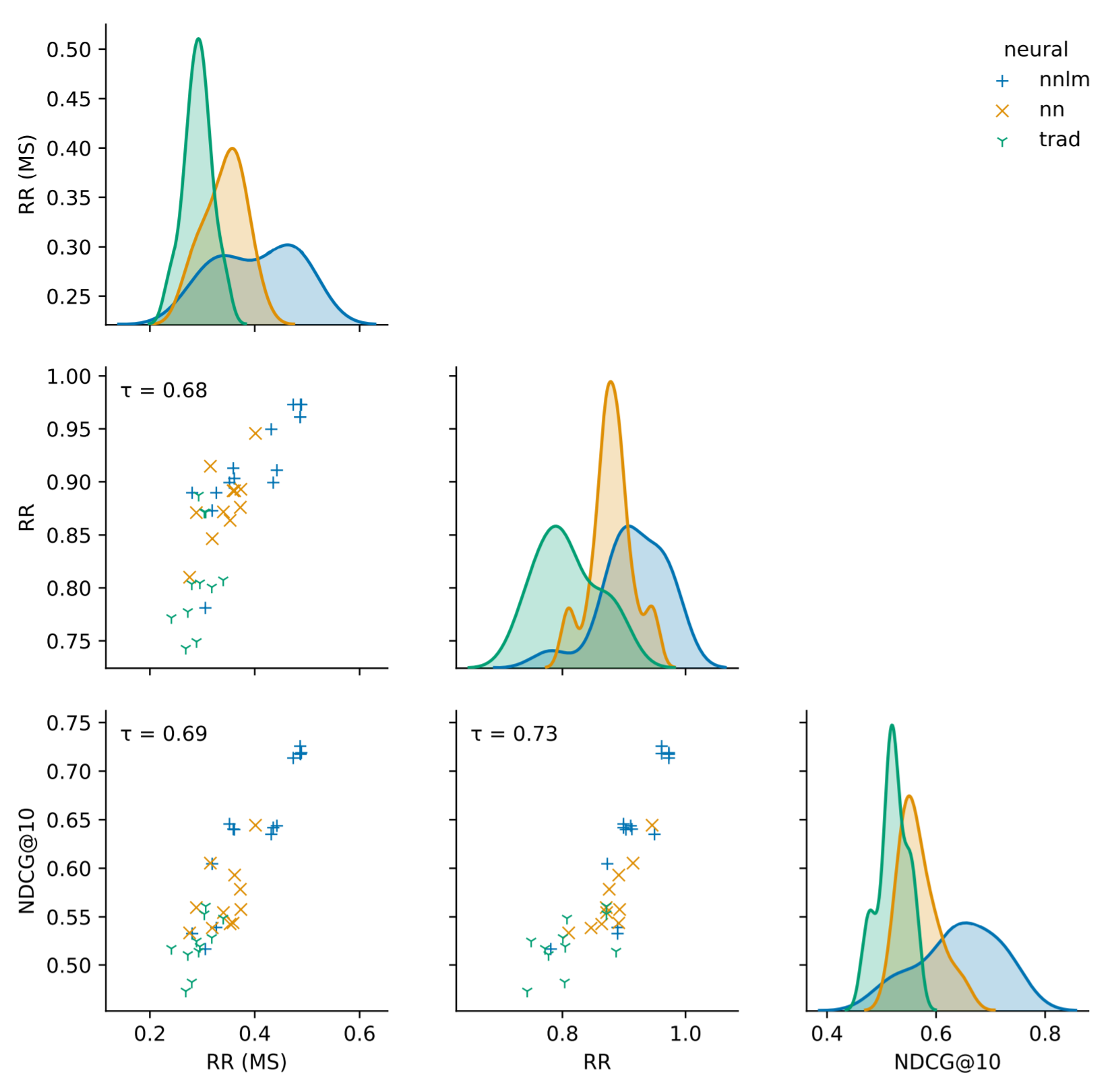
Metrics analysis: Document ranking

Slide 20
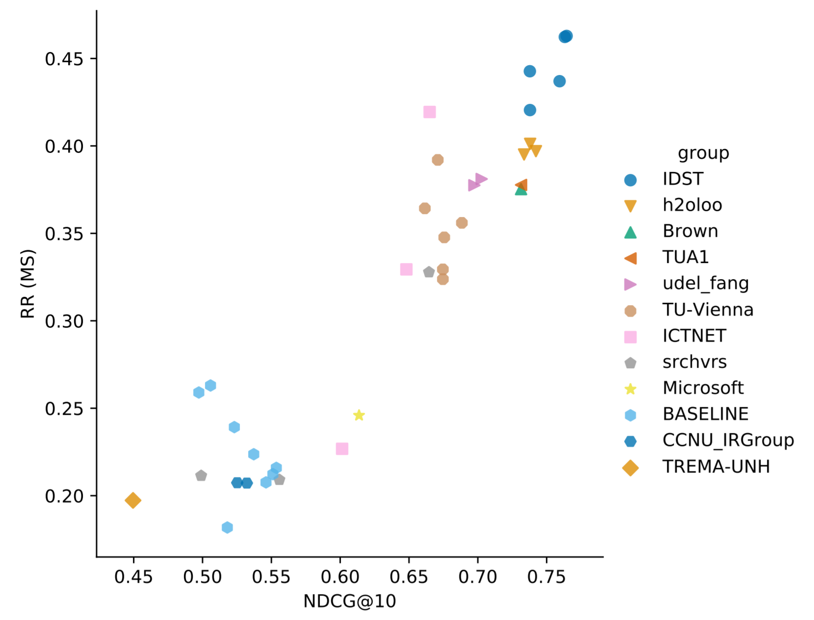
Metrics analysis: Passage ranking

Slide 21
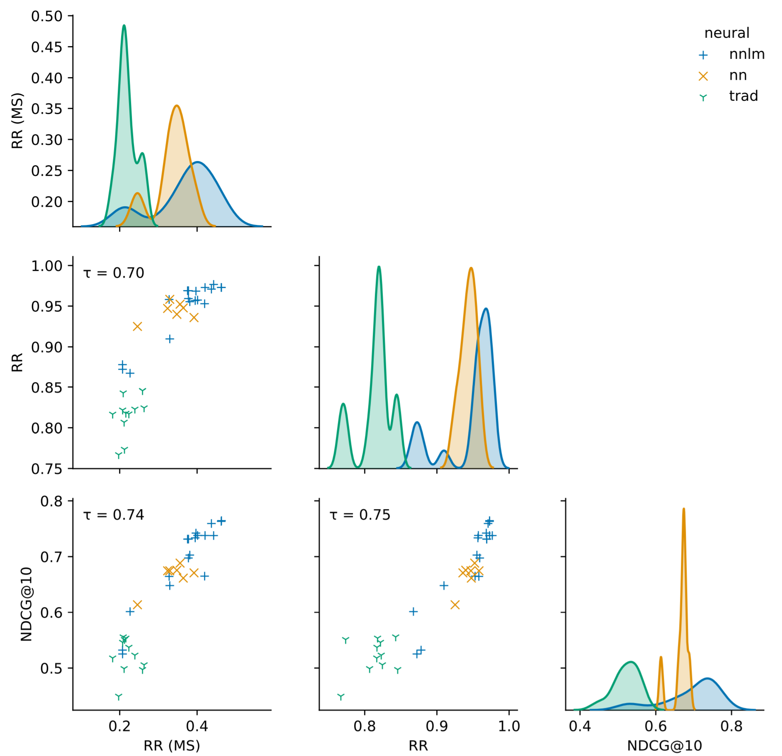
Metrics analysis: Passage ranking

Slide 22
Conclusion
Two large datasets with 300+K training queries and reusable test set
“nnlm” does well
“fullrank” and “rerank” are not that different this year
Next year: Repeat, hopefully even more variety+baselines, study transfer learning, study learning curve

